Slide 1
CAPSTONE PROJECT
BUSINESS ANALYST BATCH 3
BY CAMELLIA PRAMANIK

Slide 2
AGENDA :-
DATA EXPLORATION
STATISTICAL ANALYSIS
GRAPHICAL ANALYSIS
INSERT THE GIVEN DATA INTO THE SQL SERVER
IMPORT THE DATA INTO POWER BI
INTERACTIVE DASHBOARD
CONCLUSION AND INFERENCES
ENDNOTES

Slide 3
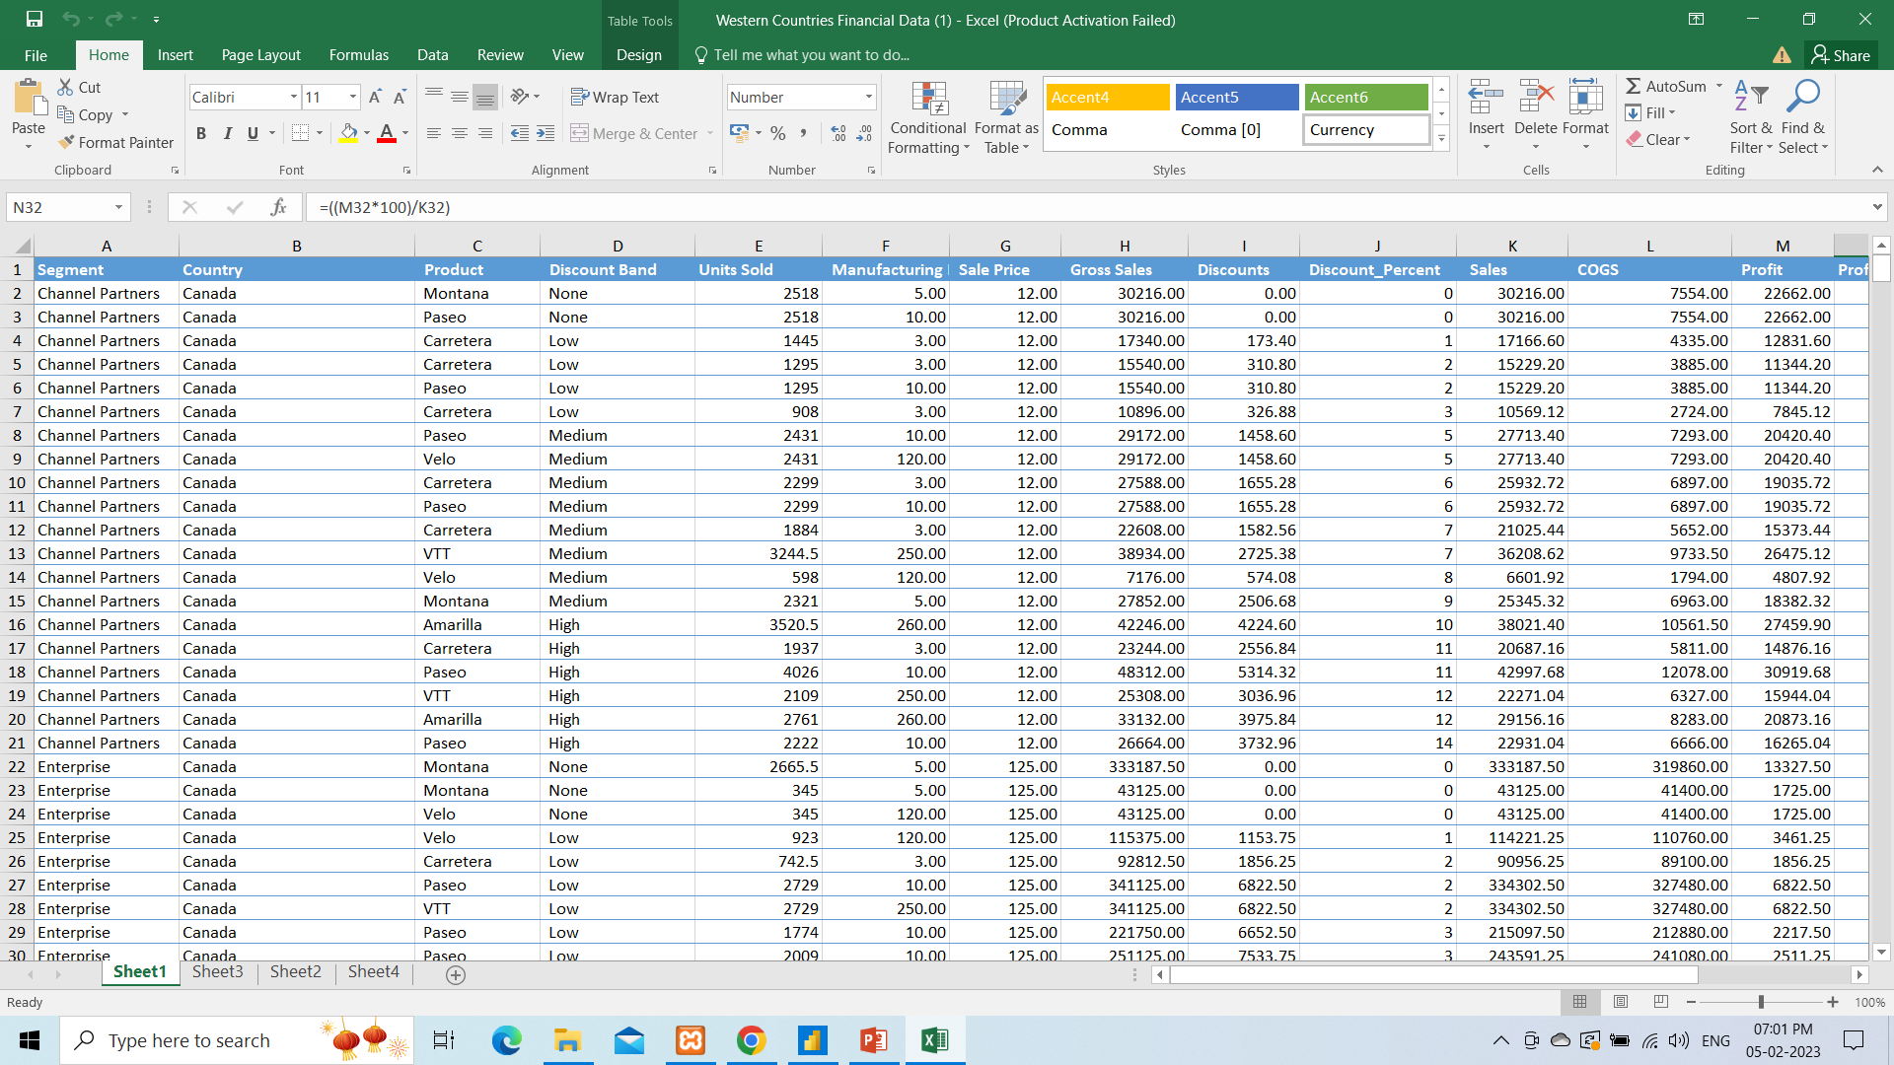
DATA EXPLORATION

Slide 4
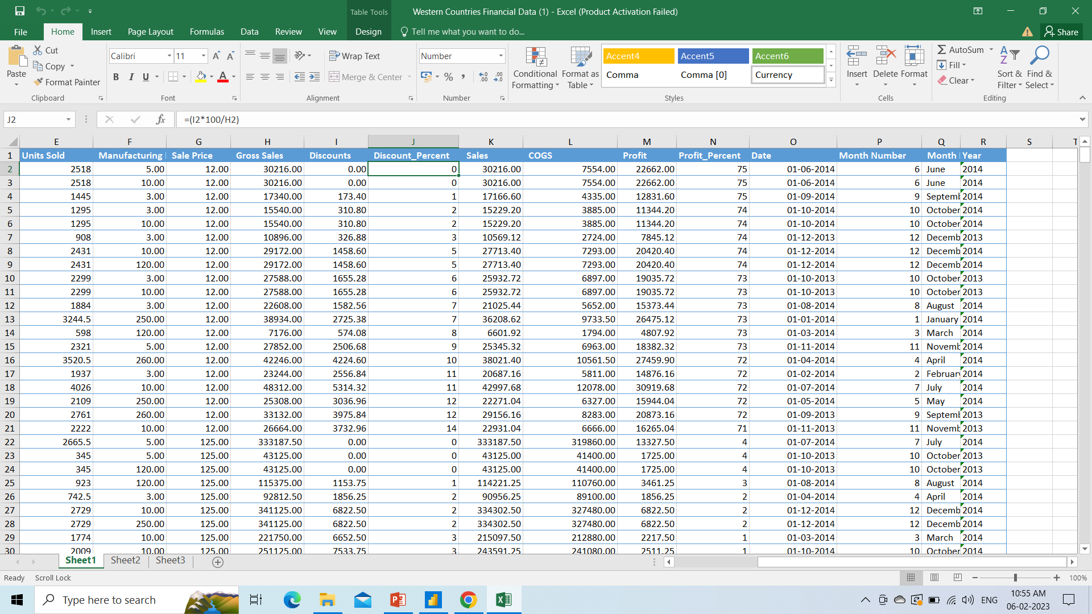
DATA EXPLORATION cont…

Slide 5
SHORT SUMMARY ABOUT THE DATA SET
Based on the observation for the western financial dataset. It can be observed that there are 16 columns which includes segment, country, product and sales, profit, discount etc.
Also, discount band along with discount, units sold, sales price, gross sales, total sales and cost of goods sold (COGS) are given along with year, month and date. So, we can calculate the discounts, profits and sales by quarterly, monthly and also yearly.
Segment and country wise profit, discount and sales calculation can be done.
Also the products’ sales, profit and discount can be checked by converting these data in percentage by applying the formulas in the excel.
I have used the following formula to derive the discount % and profit %
Profit %= (Profit * 100)/Sales
Discount% = (Discount * 100) / Gross Sales

Slide 6
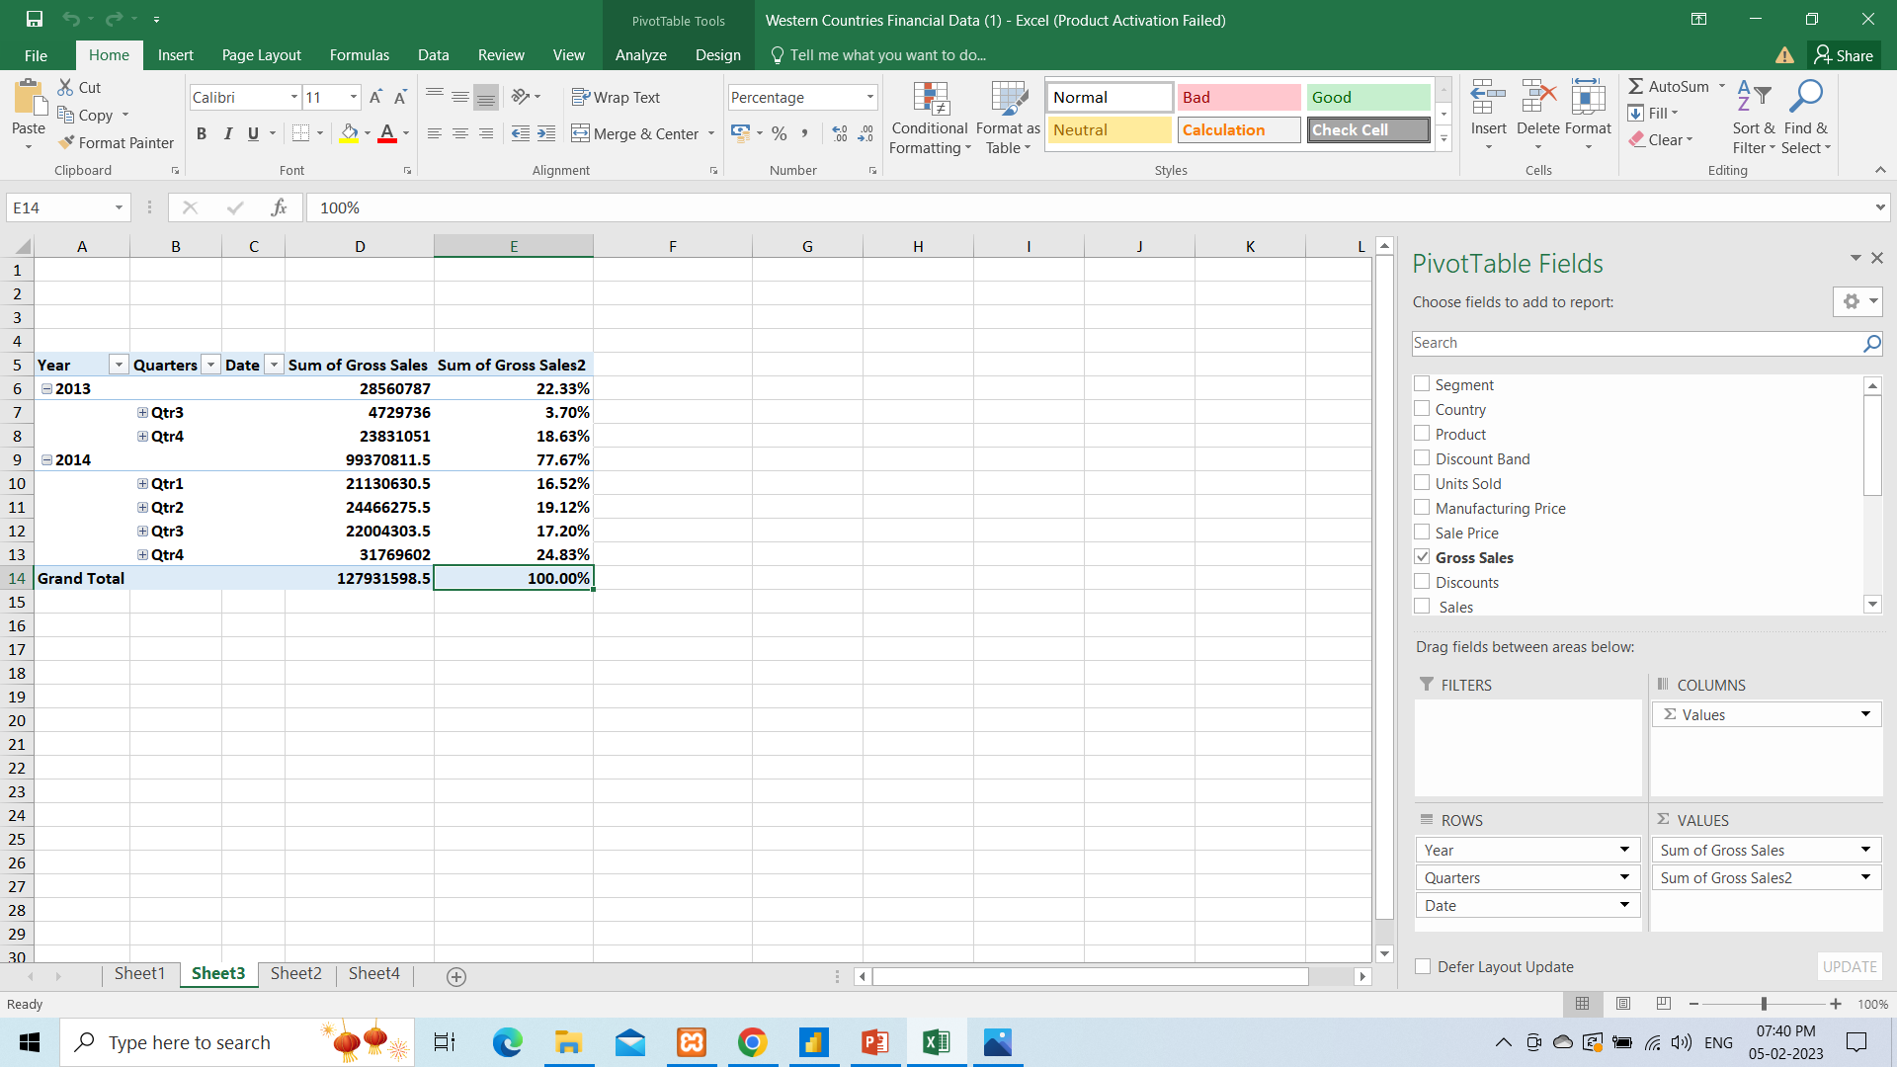
STATISTICAL ANALYSIS

Slide 7
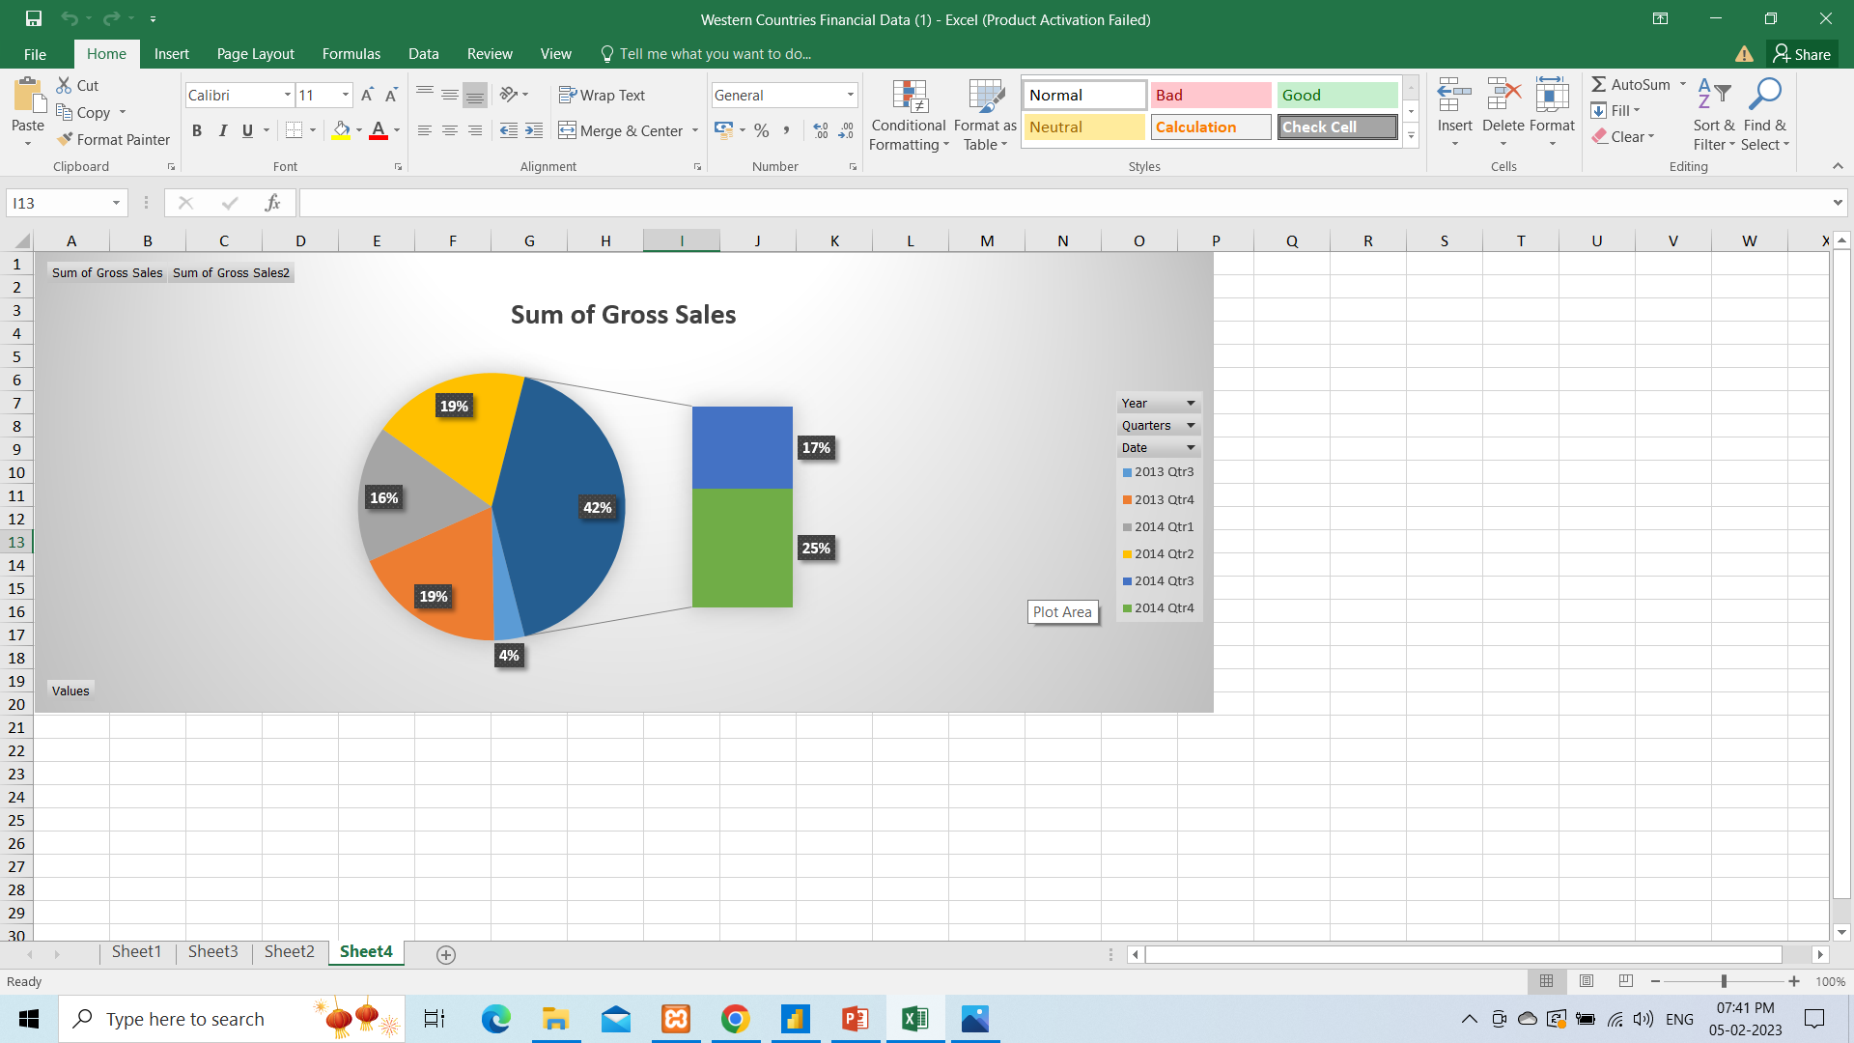
GRAPHICAL ANALYSIS

Slide 8
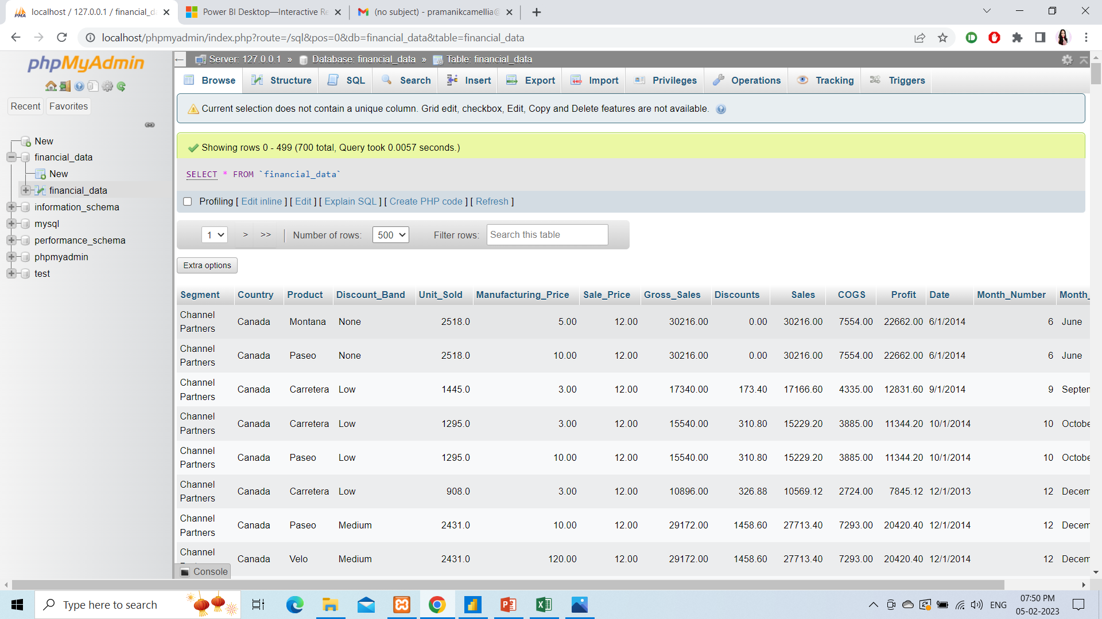
IMPORTING THE DATA INTO SQL DATABASE

Slide 9
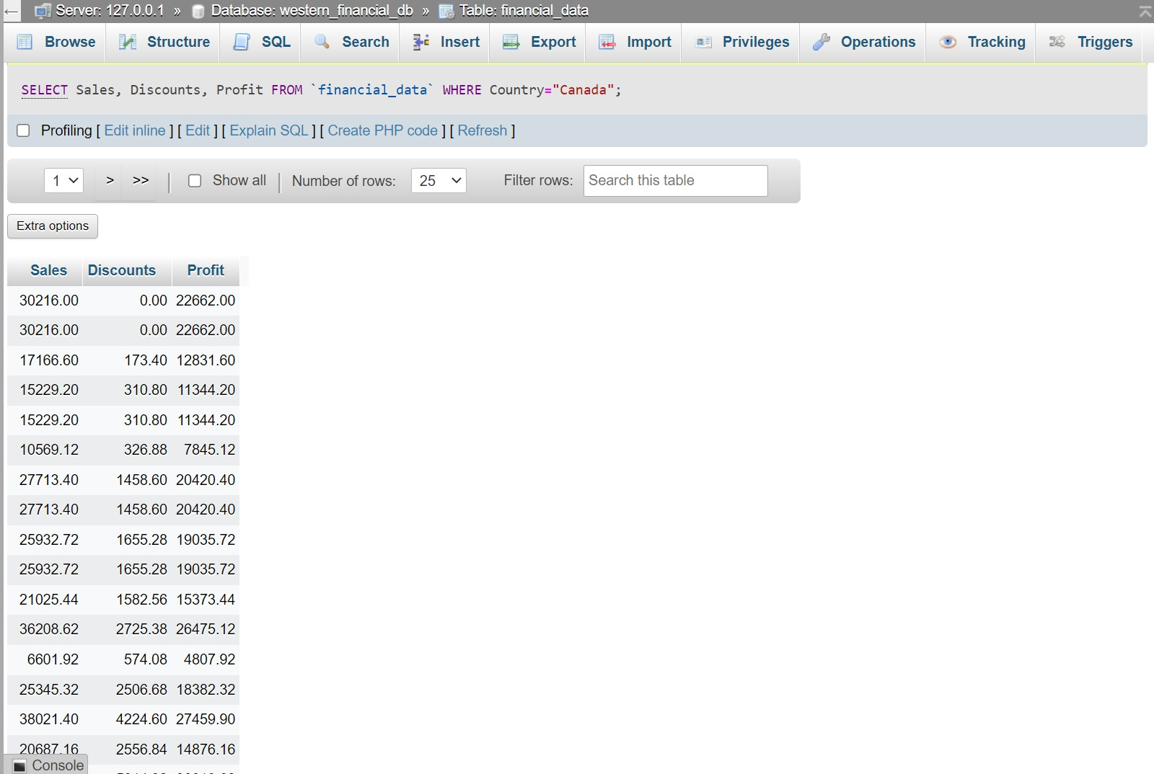
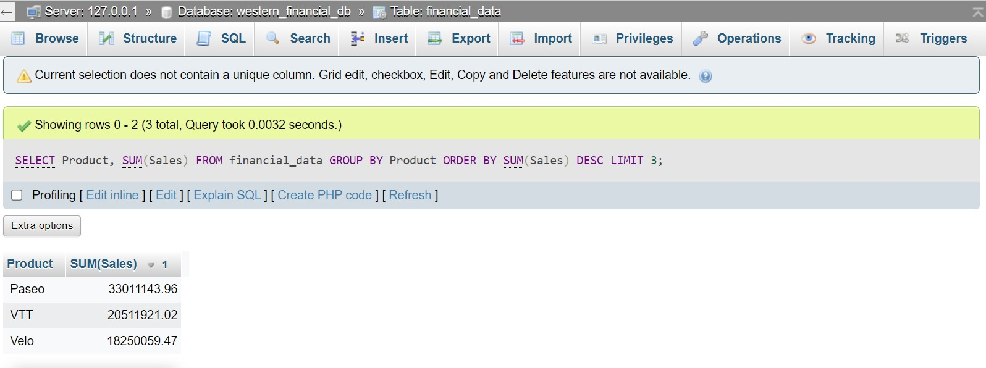
Running Query in the SQL to check the data is imported properly
Sales, Discounts and Profit of country Canada-
SELECT Sales, Discounts, Profit FROM `financial data` WHERE Country="Canada";
Top 3 products
SELECT Product, SUM(Sales) FROM `financial data` GROUP BY Product ORDER BY SUM(Sales) DESC LIMIT 3

Slide 10
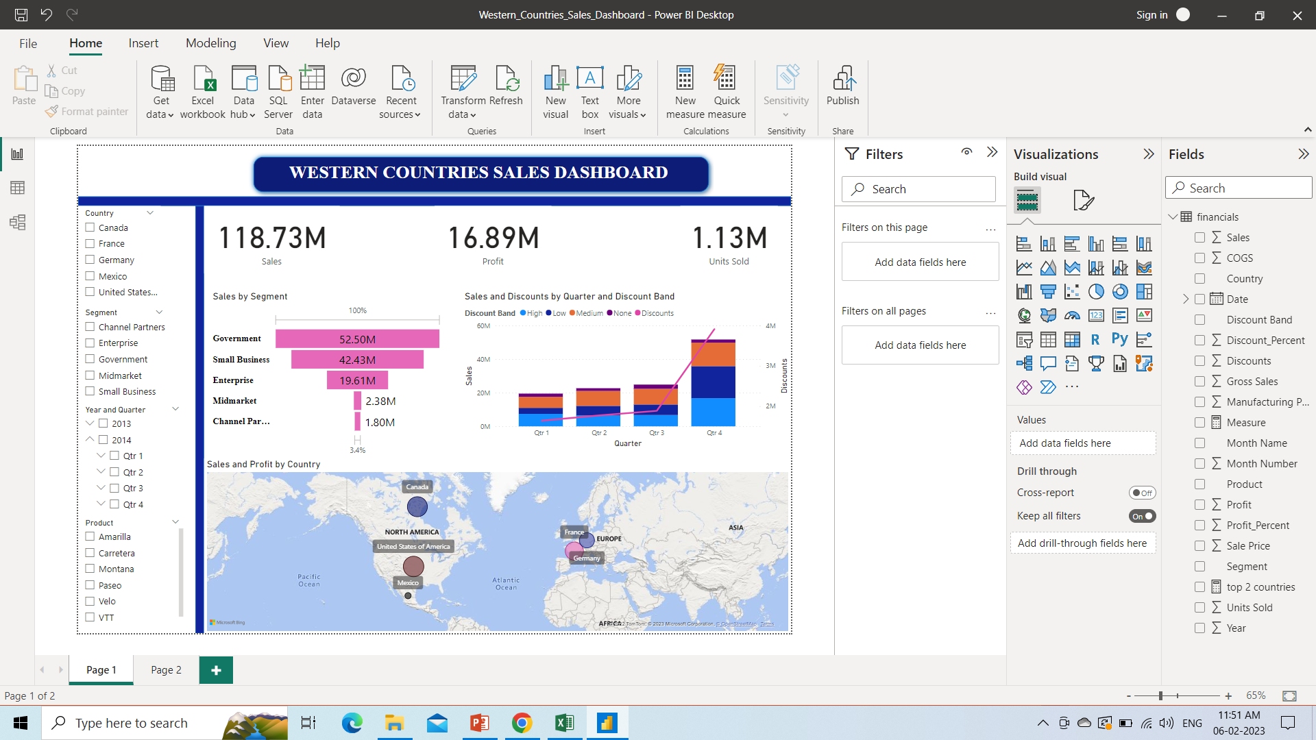
IMPORT THE DATA INTO POWER BI

Slide 11
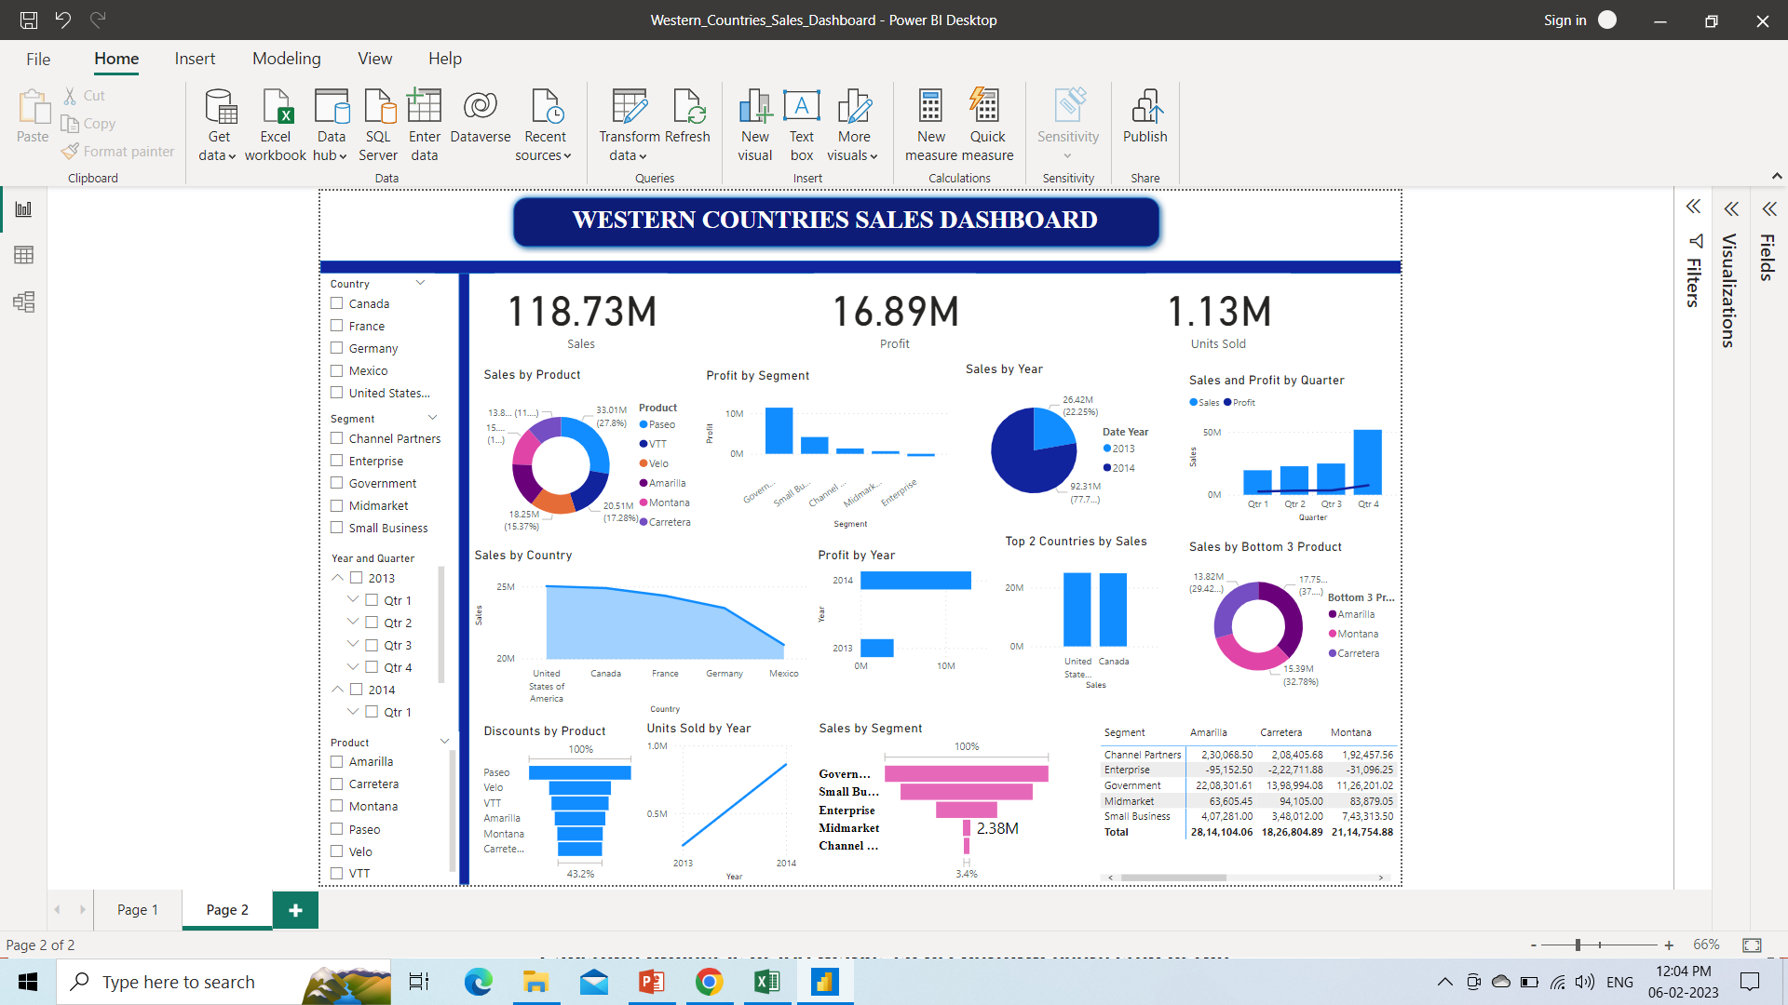
INTERACTIVE DASHBOARD

Slide 12
CONCLUSION AND INFERENCES FROM THE DASHBOARD
Government segment have the highest sales and Channel Partners have the lowest sales.
In terms of profit, Government segment have the highest profit and Enterprise have the lowest profit.
In sales by product, Paseo have the highest sales while Carretera have the lowest sales.
Country wise USA and Canada have the highest sales however, Mexico have the lowest sales.
France and Germany have the highest profit however, Mexico have the lowest profit.
In terms of discount, Paseo have the highest band of discount however, Carretera have the lowest.

Slide 13
CONCLUSION AND INFERENCES FROM THE DASHBOARD cont…
In the year 2013, there is major hike in Quarter 4 sales and profit as compared to previous quarter.
Its been observed that Quarter 4 of every year have the highest profit and sales in comparison with other quarters.
Its been concluded that discount is directly proportional to sales as the Paseo have the highest discount so it has the highest sales while, Carretera have the lowest discount so it has the lowest sales and so are the other counties.
Therefore, discount given is having major effect on the sales.

Slide 14
ENDNOTES:-
Western_Countries_Sales_Dashboard.pbix
Western Countries Financial Data.xlsx
financial_data.sql
All answers of Question 8 is given on the dashboard page2 in the Power BI file.

Slide 15
THANK YOU

